Slide 1
Unit 4- Lecture 21
Forward state space planning
Backward state space planning

Slide 2
Forward state space planning
Given a state, and given a set of operators, one can determine the actions (or moves) that can be applied in the state to generate successor states.
Forward State Space Planning (FSSP) refers to the search algorithms that start with the given state as the start state, generate the set of successor states, and search through them generating more successors till they find a state that satisfies the goal conditions.

Slide 3
A Block world problem in PDDL
Below figure depicts a planning problem from the blocks world domain.
A description of the planning problem in PDDL follows.
Observe that the domain field refers to the domain description named Blocks.

Slide 5
Let effects(a) denote all the effects of action a.
Let effect+(a) denote the set of positive effects of action a.
This is the same as the add list in the STRIPS notation.
Corresponding to the delete list, we have a similar set denoted by effects-(a).
Then given a state S in which the action a is applicable, the state S' after action a is applied is given by,
S' ← {S – effects-(a)} U effects+(a)
That is, from the sets of facts representing S, we delete the facts that are not true after the action, and add the facts that become true, resulting in the new state S'.
We say that the state has progressed through the action a.

Slide 6
Let us define a function progress(A, S) that returns the successor state when action A is applied to state S.
Given the progress(A, S) function, the search algorithms can easily be used.
They will, however, suffer from some drawbacks.
The main one being that the search space generated will be huge, and that the search algorithm will have no sense of direction.
The given state in next figure is described by the following collection of facts:

Slide 7
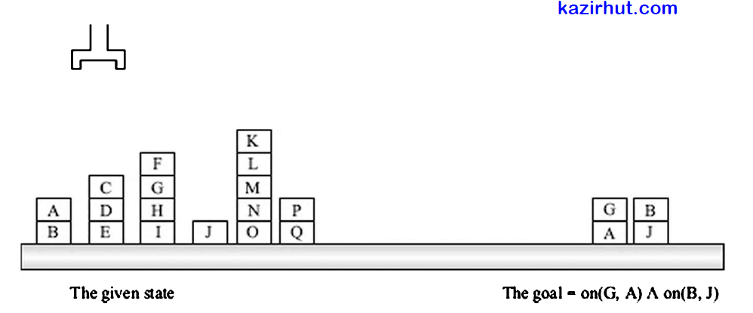
{AE, ontable(B), on(A, B), clear(A), ontable(E), on(D, E), on(C, D), clear(C), ontable(/), on(H, I), on(G, H), on(F, G), clear(F), ontable(J), clear(J), ontable(0), on(N, 0), on(M, on(L, M), on(K, L), clear(K), ontable(Q), on(P, Q), clear(P)}.

Slide 8
In the given state, one instance of the Pickup operator is applicable, generating the action Pickup(J).
Several instances of the Unstack operator are generated.
Each of the actions does a small change in the world, and many actions are applicable in turn in the changed world.
Next figure illustrates the fact that the search space generated by FSSP is huge.
Looking at the full problem, one can notice that it includes actions that have nothing to do with achieving the goal.

Slide 9
Figure 7.4 The search space generated by FSSP Is huge.

Slide 10
Backward state space planning
Like the uninformed search algorithms seen earlier, FSSP is oblivious of the goal, and simply explores the set of all future states possible in some predetermined order.
One way to take the goal state into account is to start searching backwards from the goal.
That would make the reasoning purposeful and deliberative, focused towards the goal, or teleological.
This is known as Backward State Space Planning (BSSP).
One feature strongly in support of such an approach is the fact that goal states are often incompletely specified.
That is, one often expresses only what is desired in the final state, rather than a complete description of the final state.

Slide 11
For example, at some point of time, one might have the goal of satisfying hunger.
Reasoning in a backward fashion, one will only focus on actions that will result in eating something, without worrying about anything else.
Similarly, the goal in the planning problem of figure in slide 7 is that block G should be on block A, and block B on block J.
Can we focus only on the moves that will achieve these conditions?
To do this, we have to first define the notion of regression.
This, in some sense, is the opposite of progression.
It allows us to move back from a set of goal clauses to a set of subgoal clauses.

Slide 12
For example, if in a regressed state the robot were holding block G, and block A was clear, and block B was on block J, then the stack(G, A) action would achieve the goal state of figure of slide 7.
Let preconditions(a) denote the preconditions of action a.
Given a goal g, and a relevant action a, one can regress to the goal g' as follows.
g’← {g - effects(a)} U preconditions(a)
That is, from the set of goal facts, remove the effects of the action, and add the preconditions of the action.

Slide 13
Let us define a function regress(A, G) that returns the regressed goal over action A when applied to goal G.
The regressed goal represents the minimum set of facts that must be true in a state in which the action can be applied and which would result in a goal state.
However, the regression process is not sound, in the sense that the resulting set of predicates may not necessarily represent a state.
This can happen because some actions that are relevant according to our definition may not be feasible in practice.
This may result in an invalid plan. Next figure depicts some of the problems that may crop up in backward search.

Slide 14
Figure : BSSP does not have a concrete state description to work with

Slide 15
The algorithm begins with the given goal description on(G, A) ^ on(B, J) for the problem depicted in fig. in slide 7.
Observe that if a goal predicate is true in the current state then one does not need to look for a relevant action.
Two actions are relevant here, stack(G, A) and stack(B, J).
The former regresses to a goal holding (G) ^ clear(A) ^ on(B, J), from which four operators are relevant, as shown in the figure.
The first, pickup (G), would need block G to be on the table.
But since the algorithm is working with incomplete descriptions, it does not know whether this will be so.
If block G were on some block then the way to end up holding(G) would be to unstack it from some block, but which one?

Slide 16
One way would be to instantiate an instance of unstack for each possible block in the problem.
One can see that this will soon lead to an explosion in the search tree.
The preferred method is to keep it as a variable, and instantiate it later.
Some action to achieve clear(A) would be needed if block A were not already clear.
And again, the algorithm does not know what should be unstacked from A to achieve clear(A).
Furthermore, in the action unstack(?X, A) required for clear(A), the variable ?X can be bound only to G.

Slide 17
This is because unstack(?X, A) also results in holding(?X), and the goal set requires holding(G) to be true.
However, this connection between the requirements of the two predicates holding(G) and clear(A) requires some more sophisticated reasoning.
Perhaps some kind of consistency check can force the binding of ?X to G.
The last action stack(B, J) causes a more serious problem.
It is meant to achieve the fact on(B, J).
But one can notice that the robot arm could not be holding block G (asserted in the given goal) and block B (required for the stack action) at the same time.

Slide 18
This shows that the algorithm could be reasoning with collections of facts that are not states.
Next figure illustrates how a sequence of actions that is not a plan could be found by unchecked backward search.
We consider a simple problem where in the given state three blocks, A, B and C, are on the table, and the goal is to stack A on B, and B on C.
The figure shows a possible trace that backward search, using the regression process, might result in.
The reader is encouraged to verify that at each stage of backward search the action chosen is relevant.

Slide 20
The reason why progression over states with planning operators works while regression does not, is that the operators are not symmetrical.
They are designed to represent actions.
An action converts a given state into a successor state.
The applicability of the action is predicated only on the given state.
If the given state satisfies the preconditions of the actions, it can be applied.
Operators (or actions) have an in-built arrow of time, and the FSSP algorithm is aligned with it.
Actions have preconditions on the given state which determine their applicability.

Slide 21
The preconditions are necessary and sufficient for applicability.
Once an action is applied to a given state, it produces a new state by adding some facts and deleting some facts.
The point is that after progressing over an action, we necessarily land up in a state.
One can say that the progression operation is closed over the state space.
Regression is done over sets of goal predicates.
A goal represents facts that one wants true in some future states.
The relevance of an action to a goal simply means that it looks like that the action could achieve some part of the goal.

Slide 22
But it does not mean that the action may be applicable in the preceding state.
For example, for the goal in the above problem (previous figure), the action stack(B, C) satisfies our definition of being relevant.
But it obviously cannot be applied as a last action in a plan, because one can only move one block at a time, and block A needs to be on block B.
The backward search algorithm being discussed could easily have found another invalid plan with stack(B, C) as the last action.
While the goal description most probably applies to a state, one can observe that the regression operator is not closed over the state space.

Slide 23
One may start with a (subset of a) state but end up with a set of predicates that is not the subset of any state.
For example, the description "holding(A) ^ clear(B) ^ holding(B) ^ clear(C)" in the figure cannot describe a state, because our robot has only one arm and cannot hold two blocks.

